Slide 1


Slide 2


CONTENT
REDBOXDAPP.COM
01
About RED BOX DAPP
The development of DAPP Technology
02
03
Multi-ecosystem with RED BOX
04
Potentiality of development of
RED BOX & Advantages of RBD
05
Issue ITO to raise fund for technology
development
06
Development roadmap of RED BOX

Slide 3

ABOUT
RED BOX DAPP

Slide 4

1
ABOUT RED BOX DAPP
RED BOX DAPP is a decentralized Fintech project, creating a decentralized fund solution to build a strong financial community.
With DAPP, rights and responsibilities are equal among members of the RED BOX community
RED BOX
DAPP
Whoever or wherever you are, with your contributions to RED BOX you will receive commensurate values ​​from the community.

Slide 5
1
RED BOX DAPP – GROWING UP COMMUNITY VALUE
RED BOX RESERVE FUND
RED BOX OPEN FUND
RED BOX GLOBAL TRADE FUND
RED BOX reserve fund is made public to all members of the community.
RED BOX members who meet the prescribed requirements can withdraw funds from the escrow fund.
Funds for developing a multi-ecosystem support community
Use for raising funds according to RED BOX criteria.
The global trading fund is openly transparent to all members.
Global trading fund helps investors increase profits through RED BOX AI technology.
All information is made public through the RED BOX SMART CONTRACT portal, which allows community members to control and share their rights and responsibilities together.

Slide 6
1
DEVELOPMENT AND LEGAL GROUP
DEVELOPMENT AND LEGAL GROUP
RED BOX is developed by many Smart Contract engineers in many countries and has its headquarters located in the United Kingdom.
For DAPP, the most important factor is to create common values ​​for the community. Besides, Legal is also one of the most essential factors for RED BOX to recruit talented human resources to RED BOX to create stronger surrounding ecosystems and create a strong community in the future.

Slide 7
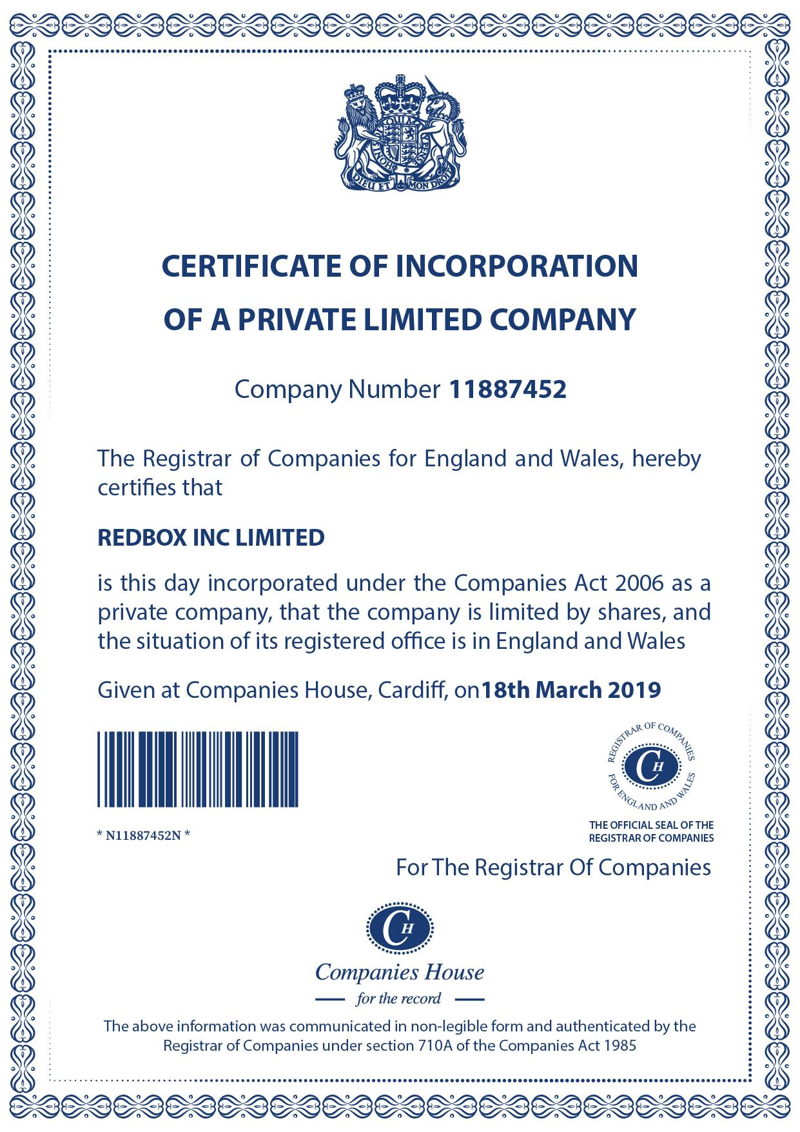
1
DEVELOPMENT AND LEGAL TEAM
Name: REDBOX INC LIMITED
Number Company: 11887452
Address: 71 – 75 Shelton Street Covent Garden
London England WC2H 9JQ

Slide 8
DEVELOPMENT OF DAPP

Slide 9
2
DEVELOPMENT OF DAPP
01
02
DAPP (Decentralized Applications) is a decentralized application.
Dapp was created as the continuation of Blockchain technology and smart contract.
RED BOX applies DAPP application based on MetaMask network directly connected to ETH smart contract.
03
04
With public APIs, other ecosystems can connect and develop on the main smart contract created by RED BOX
With decentralized DAPP technology, everyone can actively promote their full potential and capacity as well as control their own privacy.

Slide 10
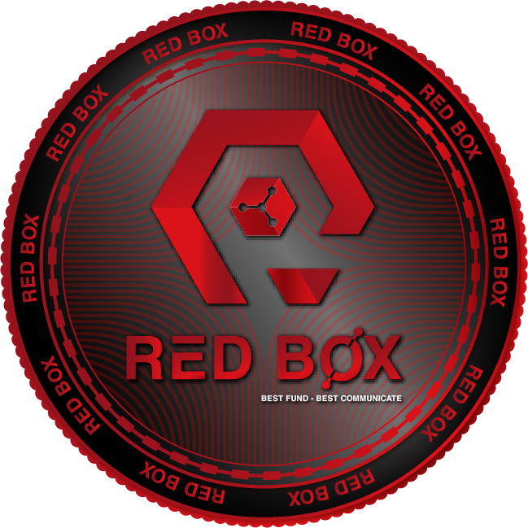
2
DEVELOPMENT OF DAPP
DEVELOPMENT OF DAPP
RED BOX applies Smart contact to create a system that works with ERC20 to create RBD tokens.
RED BOX TOKEN is considered as the main payment currency in the arounding ecosystems RED BOX CONTRACT

Slide 11
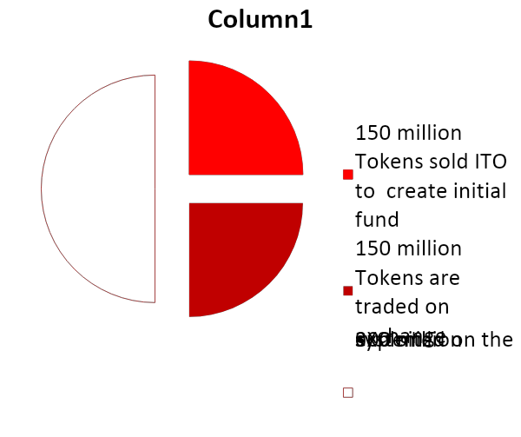
2
DEVELOPMENT OF DAPP
RED BOX
TOKEN
& Distribution
25%
Name: RED BOX Dapp Token
Ticket: RBD
Total supply: 600 millions Token
50%
25%
150 million Tokens sold ITO to create initial fund and allocate working capital to create ecosystems around Red Box.
150 million Tokens are traded on international exchanges.
300 million Tokens is operated under Smart Contract operating system and built surrounding ecosystems..

Slide 12
MULTI-ECOSYSTEM RED BOX

Slide 13
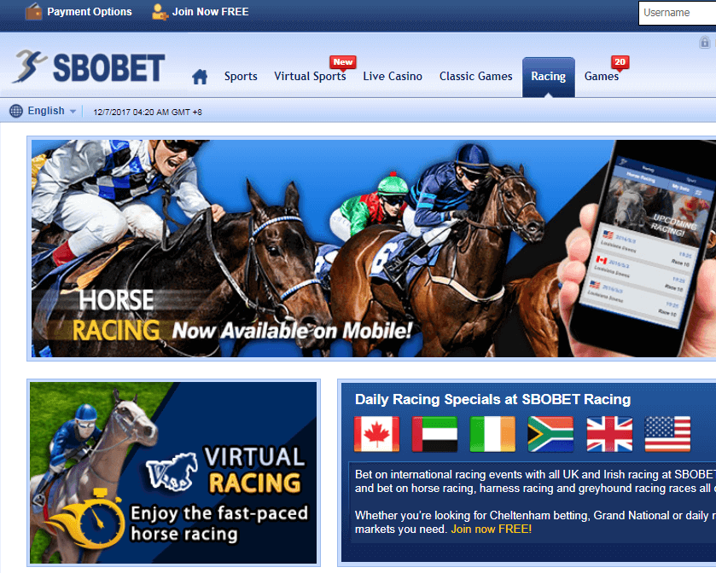
3
MULTI-ECOSYSTEM RED BOX
DEPOSIT PORT
The direct deposit gateway called RED BOX IBET Gate allows users to use RBD coins to participate in intellectual betting games in the sbobet system. Besides, it provides AI Score which analyzes and increase the probability of winning up to 85%

Slide 14

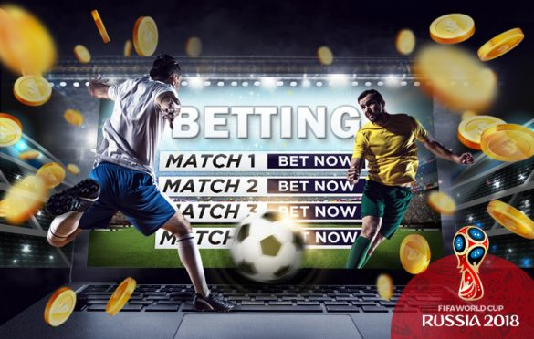



3
RED BOX GATE & AI SCORE TECHNOLOGY
With a certain amount of RBD, punter are offered a betting prediction in a soccer match with a probability of winning up to 80% with AI Score technology
AI Score will analyze the player's stats, physical strength, odds of the Bookmaker in a football match and provide the Trader with the most appropriate odds with the chance of winning up to 85%.
RED BOX is a direct partner of Sbobet
Traders can use RBD to receive Sbobet accounts and other sports betting accounts.
AI Score can be installed on ibet and use RBD to buy predictive analytics of AI Score for a higher win rate.

Slide 15
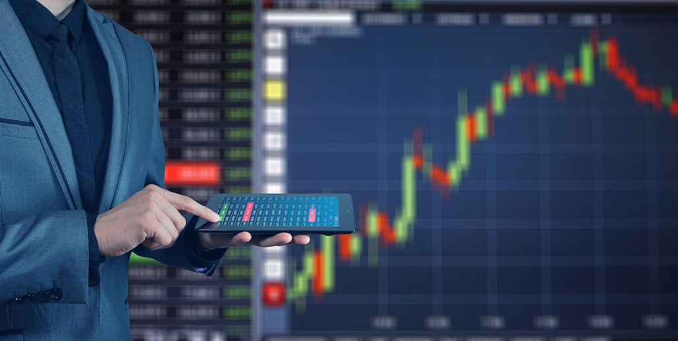
3
RED BOX AI MULTI-EXCHANGE TRADING TECHNOLOGY
Prices traded on the exchanges are never the same at the same time. This difference is due to the difference of fees such as: Entry fee, floor fee, withdrawal fee, deposit fee, overnight fee ..., each fee will be calculated according to the regulations on each floor.
Multi-Exchange trading is a form of trading which gets profits from the difference among price of the exchanges
Although knowing the difference in this fee, Traders can only think about which floor fee is lowest to play, which is most beneficial.

Slide 16

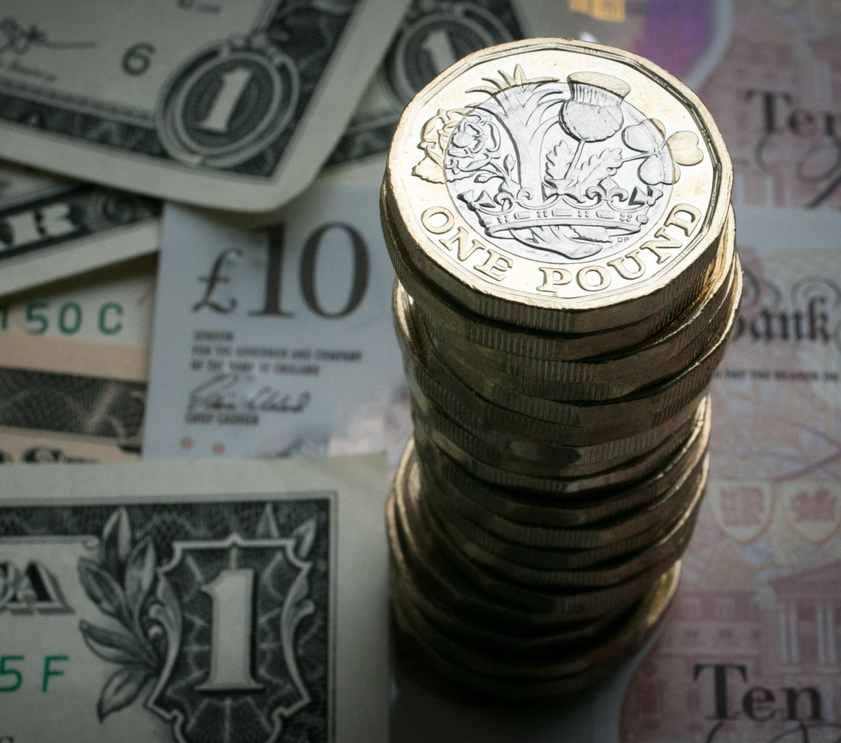
3
RED BOX AI MULTI-EXCHANGE TRADING TECHNOLOGY
In fact, the trader making the right or wrong decision depends largely on the risk factor.
RED BOX AI is created with the goal: Whether the trader loses or wins, he can still keep their profits.

Slide 17

3
RED BOX AI MULTI-EXCHANGE TRADING TECHNOLOGY
According to the reported data, RED BOX AI will make a decision to trade the same amount of money on at least two Exchanges at the same time with both BUY and SELL Comeinand so that when closing the comeinand, no matter which comeinand wins, RED BOX AI is also the one who gets profits.
RED BOX AI will read, compare and calculate ratios and spreads of all prices on the top 10 exchanges which have the largest trading volume. Then the system will statistic and analyze data continuously in second.

Slide 18
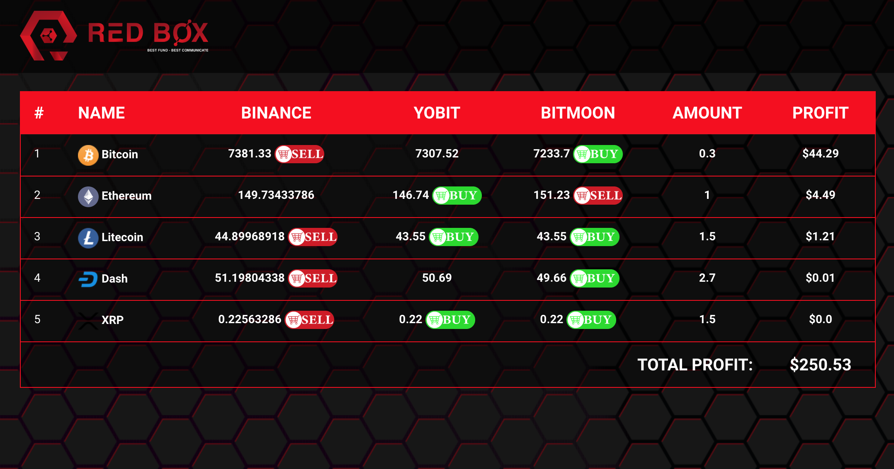
3
RED BOX AI MULTI-EXCHANGE TRADING TECHNOLOGY

Slide 19
POTENTIALITY OF DEVELOPMENT OF
RED BOX
&
ADVANTAGES OF RBD

Slide 20
4
POTENTIALITY OF DEVELOPMENT OF RED BOX
ADVANTAGES OF RBD
POTENTIALITY OF DEVELOPMENT OF RED BOX
01
03
Allow technology teams to raise fund to develop RED BOX open ecosystem and create new ecosystems specifically for the RED BOX community
RED BOX is developed by many engineers specializing in Smart Contract
There are many people in many countries following the project because of the potentiality of RED BOX
02

Slide 21
4
POTENTIALITY OF DEVELOPMENT OF RED BOX
ADVANTAGES OF RBD
POTENTIALITY OF DEVELOPMENT OF RED BOX
04
06
With the growth in the number of ecosystems, the RED BOX meets most of the community's concerns such as ecosystems: Sbobet loading port, BO trading platform, inter-exchange tool trade, etc.
With RED BOX 's development, creating a supply of tokens before running the ecosystem is essential to balance the market.
During ITO, RED BOX is able to officially operate at least 2 ecosystems with the aim of proving the outstanding growth of RBD, this is something no project has ever done.
05

Slide 22


4
POTENTIALITY OF DEVELOPMENT OF RED BOX
ADVANTAGES OF RBD
?
ADVANTAGES OF RBD
The RBD is used to deposit to the Ibet Game page through the RED BOX's portal ecosystem which helps owners buy points and participate in intellectual betting games, especially, the owner can exchange RBD into any currency when they win.
In Q2-2020, RBD will be on at least two international exchanges which creates opportunities for RBD transactions and extremely expanding. That means, investors will be able to get profits more than 5 or 10 times compare to their initial investment.
With RBD, the gaming community can create a playground by themselves

Slide 23
4
POTENTIALITY OF DEVELOPMENT OF RED BOX
ADVANTAGES OF RBD
?
Advantages of RBD
During this period, the RBD will be mainly used by the Trader for trading because of its good liquidity, guaranteed when directly traded on international exchanges, the transaction fee of this currency on the exchange is also extremely low.
RBD will be used to purchase goods on e-commerce sites in Q4-2020 at 50% cheaper than traditional market. This will make more and more people want to own RBD and push its price higher than ever.
Focusing on building ecosystems using RBD at the first stage is a prerequisite to demonstrate the practical value of this currency is an extremely smart strategy of the development team.
RBD is currently being considered as a currency with extremely high potential development because there are many communities that desire to own and use for development.

Slide 24
ITO ISSUEING SCHEDULE AND AGENCY POLICY

Slide 25
5
ITO ISSUEING SCHEDULE
With the potentiality of development and the increasing value of the RBD.
RED BOX will issue ITO in the first 3 months to make the community to believe in the RED BOX project and wish to own the first RED BOX coins.
RED BOX will issue 150 million for sale
A round will open for 5 days
Starting price: $ 0.0505
Note:
From round 1 to round 4, each account is allowed to buy up to $ 1000 and a minimum of $ 100
The round may end earlier when the number of RBDs in that round is totally owned by the investor before the end of that round

Slide 26
5
ITO ISSUEING SCHEDULE
With a strategy and plan prepared carefully, RED BOX will release a number of tokens to balance the market when there is an ecosystem and gives the community the opportunity to own RBD at a good price.
Investors can sell RBD immediately at the end of Round 1 to get their first profit. This is way of RED BOX to thank for the investor's companion with the project.
ROUND 1
Time for sale:
From 01/05/2020 to 01/09/2020
Time to start :
01/20/2020 ( From break time of round 2)
Opening time:
9 AM GMT + 00:00 - 4 PM UTC +7
ISSUE 5 MILLION TOKENS AT PRICE $0.0505
Day 1: 200,000 Tokens
Day 2: 500,000 Tokens
Day 3: 800,000 Tokens
Day 4: 1,200,000 Tokens
Day 5: 2,300,000 Tokens
Investors can exchange RBD during breaks between rounds.
Note:
From round 1 to round 4, each account is allowed to buy up to $ 1000 and a minimum of $ 100 per round
The round may end earlier when the number of RBDs in that round is totally owned by the investor before the end of that round

Slide 27
5
ITO ISSUEING SCHEDULE
At Round 2, RED BOX will officially put the first ecosystem into operation. Moreover, investors owning the RBD at Round 1 can start to get profits from the increasing price of RBD, they also can use the RBD to make their own TERROR profits by participating in the IBET.
ROUND 2
Time for sale:
From 01/15/2020 to 01/19/2020
Time to break:
01/20/2020 – 01/24/2020
Opening time :
9 AM GMT + 00:00 - 4 PM UTC +7
ISSUE 10 MILLION TOKENS AT PRICE $0.055
Day 1: 500,000 Tokens
Day 2: 1,000,000 Tokens
Day 3: 1,500,000 Tokens
Day 4: 3,000,000 Tokens
Day 5: 4,000,000 Tokens
Note:
From round 1 to round 4, each account is allowed to buy up to $ 1,000 and a minimum of $ 100 per round
The round may end earlier when the number of RBDs in that round is totally owned by the investor before the end of that round

Slide 28
5
ITO ISSUEING SCHEDULE
ROUND 3
ISSUE 15 MILLION TOKENS AT PRICE $0.060
Day 1: 500,000 Tokens
Day 2: 1,000,000 Tokens
Day 3: 2,500,000 Tokens
Day 4: 4,500,000 Tokens
Day 5: 6,500,000 Tokens
With the strategy of putting RBD into the IBET ecosystem in Round 2 of issuing ITO, RED BOX has proven its ability to develop when pushing the demand for ownership of RBD high.
Round 3 with a steady increase in price has helped investors participating in owning RBD in the first Round to see their profits grow strongly every Round.
According to the development plan, RED BOX will release the Forex & Coin trading system using RBD as the official currency when it releases ITO Round 3. In particular, in January 2020, RED BOX also officially launched RBD on the international exchange, helping investors to liquidate RBD anytime and anywhere.
Time for sale :
From 01/25/2020 to 01/29/2020
Time to break:
01/30/2020 – 02/03/2020
Opening time :
9 AM GMT + 00:00 - 4 PM UTC +7
Note:
From round 1 to round 4, each account is allowed to buy up to $ 1,000 and a minimum of $ 100 per round
The round may end earlier when the number of RBDs in that round is totally owned by the investor before the end of that round

Slide 29
5
ITO ISSUEING SCHEDULE
ROUND 4
By completing the goal of putting the ecosystem into operation at the time selling ITO and proving the value of RBD by appearing on international exchanges, RED BOX has strengthened its belief, position and community. co-investors. With Round 4, the RBD value increases dramatically, resonating with the need to own RBD in the IBET ecosystems, Forex, coin and RBD transactions ensure the profit value for investors who have accompanied. RBD for a short time The value of RBD's growth at Round 4 has reached more than 30% compared to the time of the ITO release.
Not to mention that you can earn instant profits from the RED BOX ecosystem: the IBET, Forex and Coin exchanges!
ISSUE 15 MILLION TOKENS AT PRICE $0.066
Day 1: 800,000 Tokens
Day 2: 1,200,000 Tokens
Day 3: 2,500,000 Tokens
Day 4: 3,500,000 Tokens
Day 5: 6,700,000 Tokens
Time for sale :
From 02/04/2020 to 02/08/2020
Time to break:
02/09/2020 – 02/13/2020
Opening time :
9 AM GMT + 00:00 - 4 PM UTC +7
Example: You own 20,000 RBD at Round 1, your ownership value will increase to 26,000 RBD at Round 4
Note:
From round 1 to round 4, each account is allowed to buy up to $ 1,000 and a minimum of $ 100 per round
The round may end earlier when the number of RBDs in that round is totally owned by the investor before the end of that round

Slide 30
5
ITO ISSUEING SCHEDULE
ROUND 5
ROUND 6
ISSUE 15 MILLION TOKENS AT PRICE $0.07
Day 1: 1,000,000 Tokens
Day 2: 2,000,000 Tokens
Day 3: 3,000,000 Tokens
Day 4: 4,000,000 Tokens
Day 5: 5,000,000 Tokens
ISSUE 20 MILLION TOKENS AT PRICE $0.077
Day 1: 1,000,000 Tokens
Day 2: 2,500,000 Tokens
Day 3: 3,500,000 Tokens
Day 4: 5,500,000 Tokens
Day 5: 7,500,000 Tokens
Time for sale :
From 02/14/2020 to 02/18/2020
Time to break:
02/19/2020 – 02/23/2020
Opening time :
9 AM GMT + 00:00 - 4 PM UTC +7
Time for sale :
From 02/24/2020 to 02/28/2020
Time to break:
02/29/2020 – 03/04/2020
Opening time :
9 AM GMT + 00:00 - 4 PM UTC +7
By the end of Round 1,2,3,4, investors can be more proactive with the number of RBD they wish to own.
At this time, RED BOX was able to be confident in the growth of the RBD and the balance of the market when it was officially presented on at least 3 international exchanges, making the RBD exchange free and be more proactive.
Round 5, expanding the supply of RBD to meet the needs of RBD owners for trading and long-term storage of investors!

Slide 31
5
ITO ISSUEING SCHEDULE
ROUND 7
ROUND 8
ISSUE 20 MILLION TOKENS AT PRICE $0.08
Day 1: 2,000,000 Tokens
Day 2: 3,000,000 Tokens
Day 3: 4,000,000 Tokens
Day 4: 5,000,000 Tokens
Day 5: 6,000,000 Tokens
ISSUE 20 MILLION TOKENS AT PRICE $0.088
Day 1: 1,500,000 Tokens
Day 2: 2,000,000 Tokens
Day 3: 3,500,000 Tokens
Day 4: 5,500,000 Tokens
Day 5: 7,500,000 Tokens
Time for sale :
From 03/05/2020 to 03/09/2020
Time to break:
10/03/2020 – 14/03/2020
Opening time :
9 AM GMT + 00:00 - 4 PM UTC +7
Time for sale :
From 03/15/2020 to 03/19/2020
Time to break:
20/03/2020 – 24/03/2020
Opening time :
9 AM GMT + 00:00 - 4 PM UTC +7

Slide 32
5
ITO ISSUEING SCHEDULE
ROUND 9
ISSUE 30 MILLION TOKENS AT PRICE $ 0.1
Day 1: 2,000,000 Tokens
Day 2: 4,000,000 Tokens
Day 3: 6,000,000 Tokens
Day 4: 8,000,000 Tokens
Day 5: 10,000,000 Tokens
Time for sale :
From 03/25/2020 to 03/29/2020
Opening time :
9 AM GMT + 00:00 - 4 PM UTC +7
TOTAL ITO ISSUED DURING 3 MONTHS: 150 MILLION RBD
At the end of ITO, RED BOX officially launched ecosystems that use RBD as the official trading currency, and appeared on 03 international exchanges, confirming the important position and growth rate when helping investors achieve 200% of investment capital in the first 03 months.

Slide 33
5
AGENCY POLICY
PRESENTER
Get a commission 6% F1
Get a commission 3% F2
Condition with 2 F1
Get a commission 2% F2
Condition with 3F1
Condition:
Must own RBD from round 1 with an amount of RBD equal to $ 100
Commissions received in USD
The minimum withdrawal amount is $ 50
ID F1 – F2 – F3 must have a $ 100 input package

Slide 34
RED BOX ROADMAP

Slide 35

6
2019
RED BOX ROADMAP
Quarter I
Quarter III
Technology research, complete the project operating staff
Perfecting technology and related policies to operate RED BOX
Publish the project and issue RBD and develop the RED BOX fund creation project. Operating the RED BOX ecosystem demo
Research ITO model and development orientation of ecosystem fund. Initialize the ecosystem
Quarter II
Quarter IV

Slide 36
6
RED BOX ROADMAP
2020
QUARTER I
QUARTER IV
05/01/2020: Official opening of ITO sale, create conditions for RBD owners community with the best price.
15/01/2020: Officially operating the first ecosystem called IBET Gate, which allows owners to use RBD to participate in smart betting games on Sbobet. Officially launched the Forex and Coin trading platform, which allows the trader to use RBD to trade and increase profits from live trading. Listing RBD on two international exchanges connected from quarter II/2019
15/03/2020: launching the second ecosystem, RED BOX became the first project in the world to raise funds and develop multiple ecosystems for users.
Expand funds, corporate with a 3rd partner to use RBD as the officially traded currency.
Research the global e-commerce ecosystem, help communities buy purchase directly with RBD.
QUARTER II
RED BOX will launch a consumer ecosystem that will allow you to buy items for 50% of the market price when paying with RBD.
Promotion programs allow users to buy a 4-seater car at a price equal to 50% of the market price when paying with RBD.
Allows direct funding from Open Fun RED BOX for Start-Up projects that use RBD as the official trading currency, while supporting Start-Up technology groups to have more opportunities to develop and help the RED BOX community have the opportunity to experience new and realistic technology platforms.
QUARTER III

Slide 37

THANK YOU

